Slide 1

Citation Network Analysis using Hadoop
Kumar Sanyam (IIT2013121)
Rajat Gupta (IIT2013120)
Baishali Saha (IIT2013122)
Anurag Sharma (ISM2013018)
Shobhit Sharma (IIT2013204)

Slide 2
Contents
Work Phase
Dataset Description
Field Tagging
Citation Network
Community Network
Metrics Calculation
Performance Gain using Hadoop
Conclusion

Slide 3
Workphase

Slide 4
Phase I (pre-midsem)
Hadoop installation
Setting up multi node cluster
Benchmarking our cluster

Slide 5
Phase II (post-midsem)
Tagging various research papers to different computer science communities.
Creating a citation network of aforesaid papers.
Building a citation network of different communities.
Analyzing different metrics on the citation network.

Slide 6
Dataset Description

Slide 7
Microsoft Academic Research Data
FieldsOfStudy.txt
File size - 1.48 MB (54.2K Lines)
Field ID Field of study name
0007022 Wireless sensor network
00095A22 Resistance distance
000A44EE Artificial Intelligence
PaperKeywords.txt
File size - 4.7 GB (139.8M Lines)
PaperID keywords FieldID
00000080 current density 0C61E031
000000E1 intelligence 09EF88C5
000000E1 machine learning 03B9FD3C
00000116 Routing network 06D05151
PaperReferences.txt
File size – 19.19 GB (1.03 Billion Lines)
FromPaperID ToPaperID
0000004B 0000006A
000000B5 114367D3
0000006A 00000118
0000006A 00000569

Slide 8
Community Tagging

Slide 9
Computer Science Communities
Artificial Intelligence
Networking
Machine Learning
Algorithms and theory
Databases
Distributed and parallel community
Hardware and Architecture
Software Engineering
Scientific Computing
World Wide Web
Operating Systems
Real Time embedded systems
Bioinformatics and computational biology
Human-Computer Interaction
Multimedia
Graphics
Computer Vision
Data mining
Programming Languages
Security and Privacy
Information Retrieval
Natural Language & speech
Simulation
Computer Education

Slide 10
Tagging
Filter the research fields to obtain only those fields belonging to given computer science communities
Performed string search to obtain this result
Tag different research papers to the filtered communities
Store these papers in Hbase collection PaperAbout

Slide 11
Filtering of Computer Science Fields
00070221 Wireless sensor network
00095A22 Resistance distance
000A44EE Artificial Intelligence
C++ program to filter fields using string match
00070221 NW
000A44EE AI

Slide 12
Paper to Community Mapping
PaperID keywords FieldID
00000080 current density 0C61E031
000000E1 intelligence 09EF88C5
000000E1 machine learning 03B9FD3C
00000116 Routing network 06D05151
PaperKeywords file
Mapper : Input - <RowID, RowValue>
Output- <PaperId, FieldId>
Send the first and last column of PaperKeywords file as output to reducer.
HashMap
06D05151 NW
09EF88C5 AI
03B9FD3C ML
000000E1 AI
000000E1 ML
00000116 NW
Output stored in Hbase table PaperAbout
Reducer : input - <PaperId, FieldId>
: output - <PaperId, CommunityNamesCSV>
Tag different research papers to the the communities
RowID | Classes
000000E1 | ,AI, ML
00000116 | ,NW

Slide 13
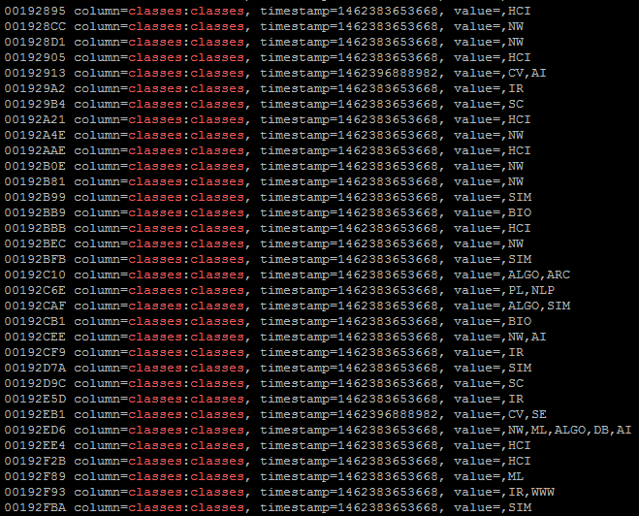
Paper to Community Mapping - Insights
Time Taken: 3 minutes 40 Seconds
Size Reduction: 4.7GB to 85MB
Entries Reduction: 139.8M to 5.4M

Slide 14
Citation Network

Slide 15
Citation Network
FromPaperID ToPaperID
0000004B 0000006A
000000B5 114367D3
0000006A 00000118
0000006A 00000569
PaperReferences.txt
Mapper
Input - <RowID, RowValue>
Output- <FromPaperID, ToPaperID>
Checks if both FromPaperID and ToPaperID exists in PaperAbout table, proceed to reducer.
PaperAbout
0000004B ,SE
0000006A ,PL
00000118 ,ML,ALGO
0000004B 0000006A
0000006A 00000118
Output stored in Hbase collection citationNetwork
Reducer
input - < FromPaperID, ToPaperID>
output - <RowID, <FromPaperID, ToPaperID>>
Write entry to PaperAbout table with RowID as FromPaperID+ToPaperID and value as one tuple of the table.
RowID | FromPaperID | ToPaperID
0000004B0000006A | 0000004B | 0000006A
0000006A00000118 | 0000006A | 00000118

Slide 16
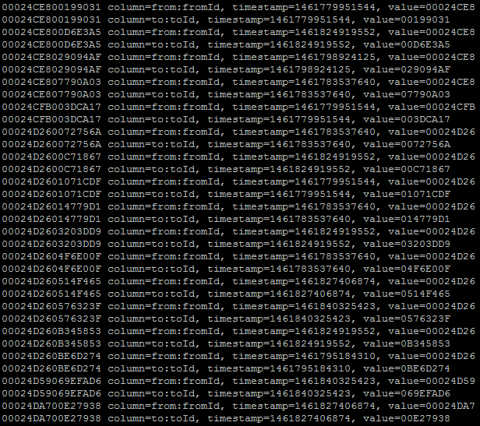
Citation Network - Insights
Time Taken: 5.7 Hrs
Size Reduction: 19.19GB to 254MB
Entries Reduction: 1.03 Billion to 15.04M

Slide 17
Community Network

Slide 18
Community Network
Hbase collection PaperAbout
Mapper
Input - <RowID, RowValue>
Output- <(FromCommunity,ToCommunity), 1>
Concats FromPaperID’s community and ToPaperID’ community, after getting respective communtiies from PaperAbout collection.
PaperAbout
0000004B ,SE
0000006A ,PL
00000118 ,ML,ALGO
RowID | FromPaperID | ToPaperID
0000004B0000006A | 0000004B | 0000006A
0000006A00000118 | 0000006A | 00000118
SE,PL 1
PL,ALGO 1
PL,ML 1
Hbase collection CommunityAbout
Reducer :
input - <(FromCommunity,ToCommunity), 1>
output - <RowID,<FromCommuntiy, ToCommunity, edgeCount>>
Counts total edges for every unique community pair and writes it to CommunityAbout collection with RowID as (FromCommuntiy,ToPaperID) and value as one tuple of the table.
RowID | From | To | EdgeCount
SE,PL | SE | PL | 1
PL,ALGO | PL | ALGO | 1
PL,ML | PL | ML | 1

Slide 19
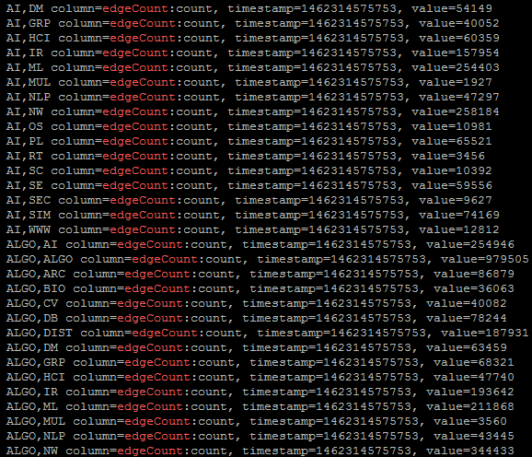
Community Network - Insights
Time Taken: 23 Minutes
No. of Entries: 529

Slide 20
Metrics Calculation

Slide 21
Metrics to be calculated
Inwardness
Expansion
Cut-Ratio
FOMD
Coductance

Slide 22
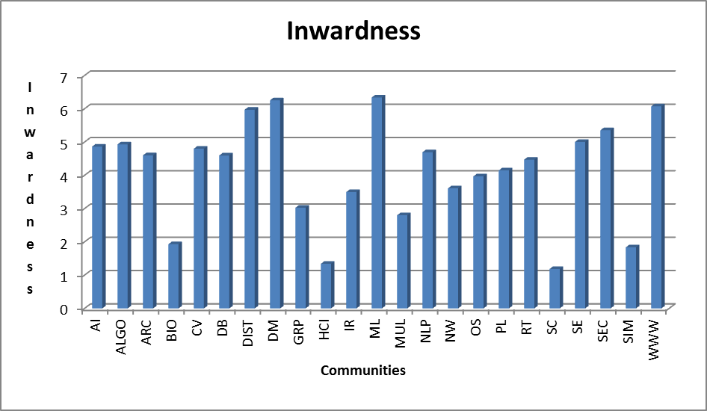

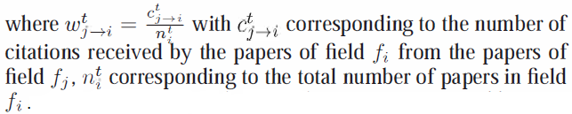
Inwardness
This inwardness metric is a measure of the degree of authoritativeness of a research community.

Slide 23
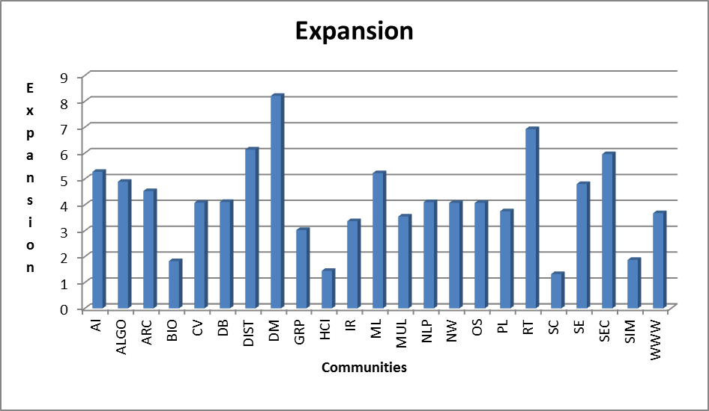
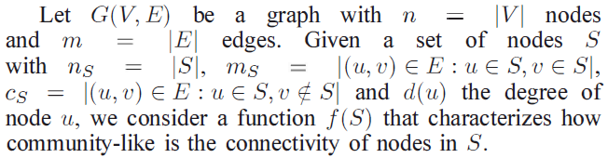
Expansion

Slide 24
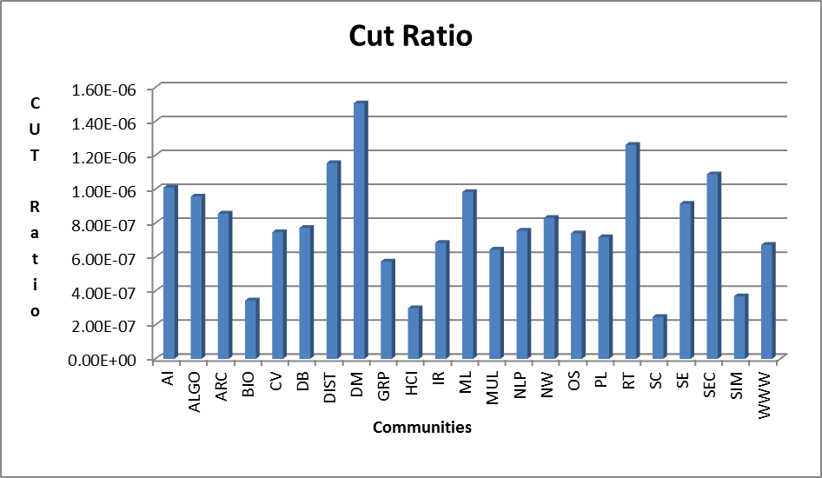

Cut-Ratio

Slide 25
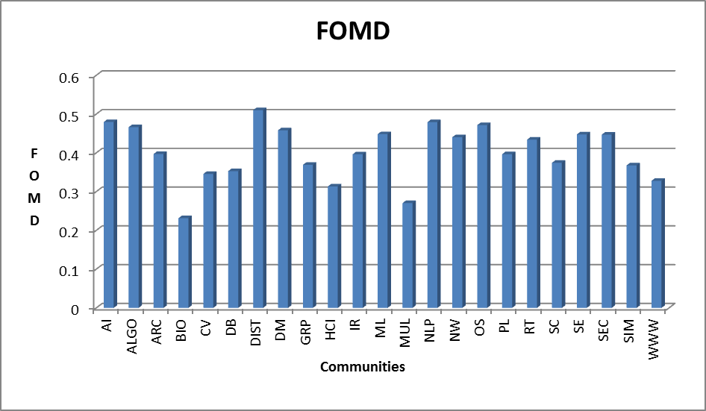
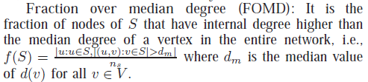
FOMD

Slide 26
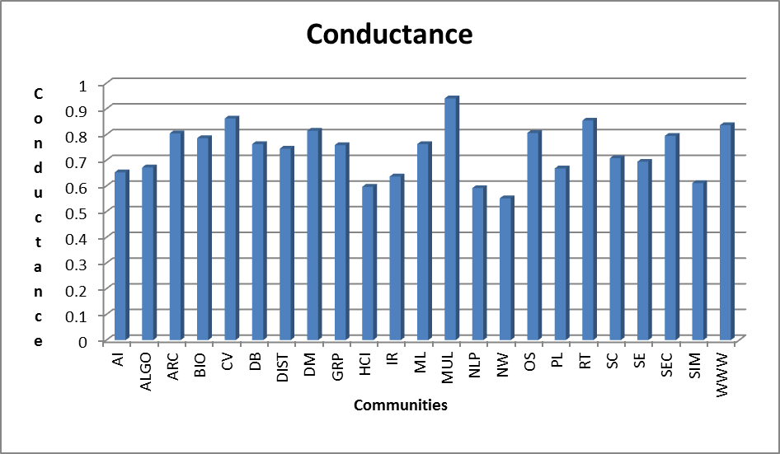

Conductance

Slide 27
Performance Gain using Hadoop

Slide 28
Performance gain using Hadoop
Time taken to filter PaperReferences file of 1.77Gb using serial processing Java code
3.5 hrs. (approx.)
The process still didn’t complete
Time taken to filter PaperReferences file of 1.77Gb using parallelized MapReduce framework
0.5 hrs. (approx.)

Slide 29
Conclusion
After building the citation and community network, we observed different metrics over this graph. These metrics give a comprehensive analysis of the citation network.
The future scope of this project involves the temporal variations of these metrics.
Another scope is to study this graph in context of Indian community and how they affect other communities in research field.

